Slide 1



COMPARATIVE CLUSTERING ANALYSIS
Human Activity Pattern
Discovery Using Smartphone
Sensor Data
Unsupervised learning on 561 inertial sensor features to recover human activity structure
Algorithms Compared
Presented by
Dr. Dipanwita Debnath
Mr. Sathish D
CSE-AIML Dept.
BVRIT Narsapur
K-Means
Hierarchical
Gaussian Mixture Model
DBSCAN

Slide 2






ROADMAP
What We'll Cover
1. Dataset & Problem
2. Data Quality & EDA
HAR sensor data, the unsupervised reframing
Integrity checks, activity distribution
3. Preprocessing Pipeline
4. Choosing K
Scaling, PCA, feature importance
Elbow method & silhouette analysis
5. Four Algorithms
6. Comparison & Verdict
K-Means, Hierarchical, GMM, DBSCAN
Metrics, ranking, best performer
Human Activity Pattern Discovery — A Comparative Clustering Analysis
2

Slide 3

Project Overview
What this analysis set out to discover
Smartphones carry accelerometers and gyroscopes that continuously record motion. The UCI Human Activity Recognition (HAR) dataset captures 561 engineered signal features per observation, each labeled with one of six activities performed by 30 volunteers. This project asks an unsupervised question: if the activity labels were hidden, would clustering algorithms rediscover six distinct behavioral groups on their own — or something simpler?
10,299
561
Total Samples
Sensor Features
6
30
1
Explore and validate the merged train/test dataset
Activity Labels
Subjects
2
Reduce dimensionality via PCA and Random Forest feature importance
3
Apply KMeans, Hierarchical, and Gaussian Mixture clustering
4
Validate clusters internally (Silhouette, DBI, CHI) and externally (ARI, NMI)
5
Interpret what the discovered clusters reveal about human activity
https://archive.ics.uci.edu/dataset/240/human+activity+recognition+using+smartphones?
Human Activity Pattern Discovery — Clustering Analysis
3

Slide 4
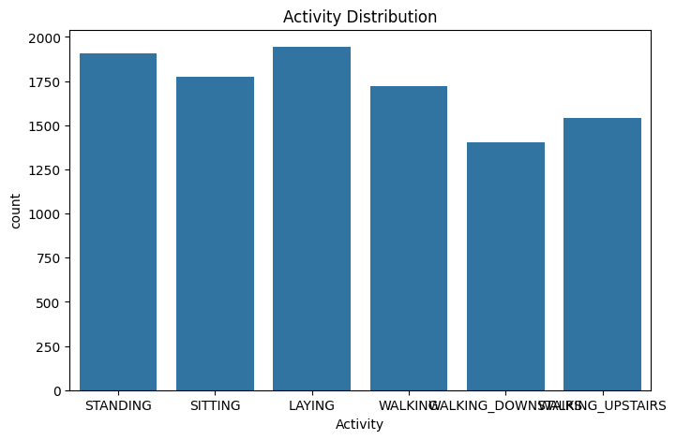

STEP 1
Data Quality Assessment
Before clustering, the dataset structure was verified to confirm it's ready for unsupervised analysis — missing values and duplicates can distort distance-based algorithms.
Missing Values
0
No nulls across all 563 columns
Duplicate Rows
0
Every record is unique
Train + Test Merged
10,299
7,352 train + 2,947 test rows combined
Activity distribution is well balanced — no class dominates, which keeps clustering bias low.
Human Activity Pattern Discovery — A Comparative Clustering Analysis
4

Slide 5



STEP 2
Preprocessing Pipeline
01
02
03
04
→
→
→
Drop Identifiers
Standardize
Reduce with PCA
Rank Features
Remove 'subject' & 'Activity' columns to isolate the 561 sensor features (X)
StandardScaler applied — zero mean, unit variance across all features
Project onto principal components that retain 95% of variance
Random Forest importance highlights the most discriminative sensors
561 → 105
82%
StandardScaler
Features after PCA (95% variance retained)
Dimensionality reduction achieved
Zero mean, unit variance normalization
Human Activity Pattern Discovery — A Comparative Clustering Analysis
5

Slide 6

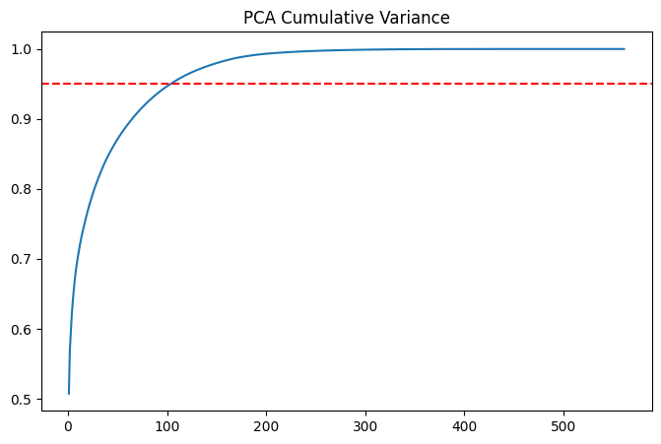
Dimensionality Reduction with PCA
Compressing 561 correlated sensor features down to their essential signal
561 → 105
components needed to retain 95% of the dataset's variance — a ~81% reduction in dimensionality.
The red dashed line marks the 95% variance threshold. The steep early rise confirms heavy redundancy among the 561 raw features (many are derived from the same X/Y/Z accelerometer and gyroscope signals), so a much smaller set of components captures nearly all the information.
Human Activity Pattern Discovery — Clustering Analysis
6

Slide 7
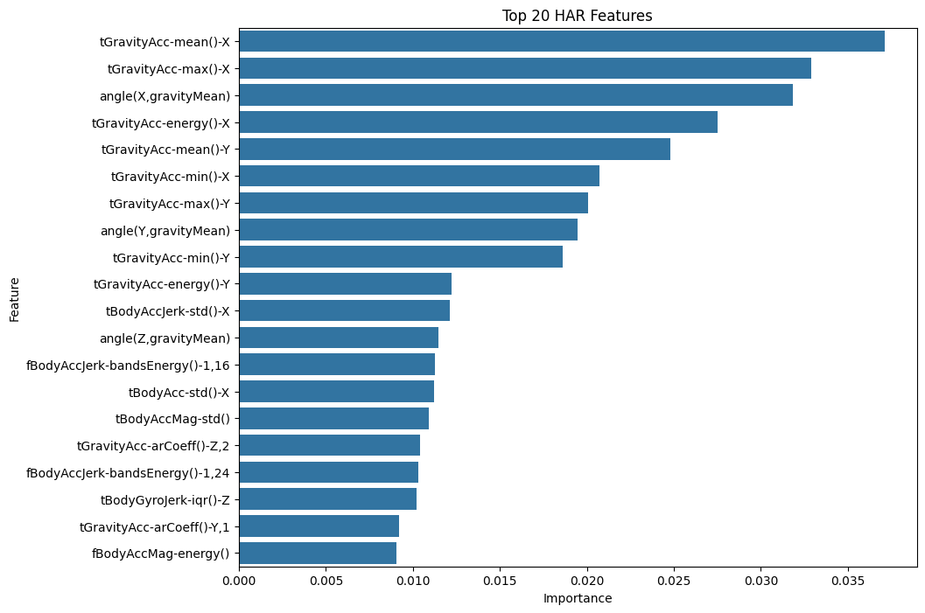
FEATURE INSIGHT
Which Sensor Signals Matter Most?
A Random Forest classifier (trained only to rank features, not for prediction) surfaces the top contributors. Gravity-axis acceleration dominates — it directly encodes phone orientation, which is highly diagnostic of posture (sitting vs. standing vs. laying) and motion.
#1
tGravityAcc-mean()-X
3.71%
#2
tGravityAcc-max()-X
3.29%
#3
angle(X, gravityMean)
3.18%
Top 50 ranked features were carried forward as a curated feature subset for downstream checks.
Human Activity Pattern Discovery — A Comparative Clustering Analysis
7

Slide 8

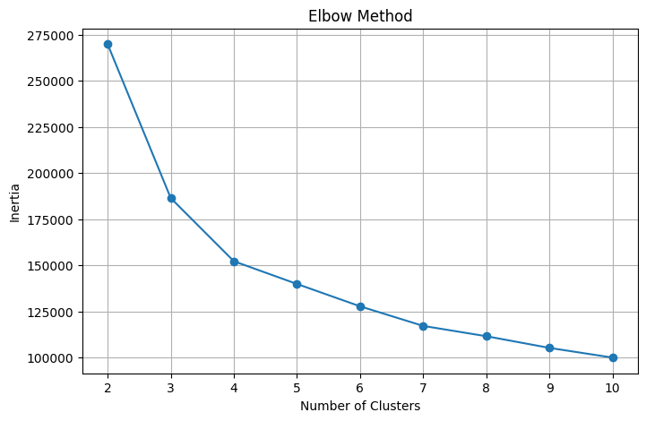
Choosing the Number of Clusters: Elbow Method
Top 50 most important features selected and standardized before clustering
50
top-ranked features carried forward into clustering (down from 561 raw / 105 PCA components)
The inertia (within-cluster sum of squares) drops sharply from k=2 to k=4, then flattens. The visible bend around k=3–4 suggests diminishing returns from adding more clusters beyond that point — consistent with the silhouette analysis on the next slide.
Human Activity Pattern Discovery — Clustering Analysis
8

Slide 9

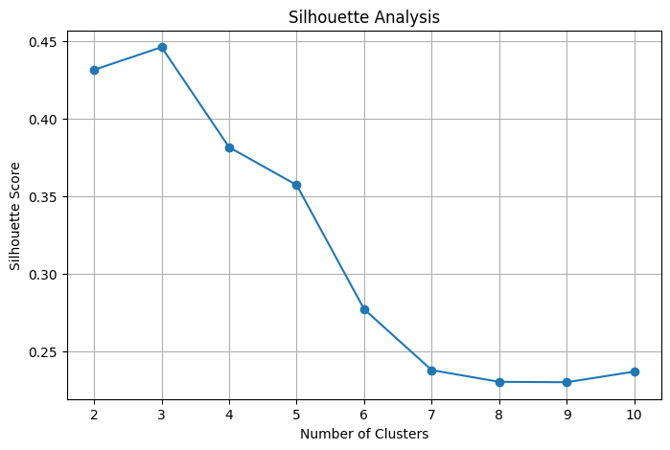
Silhouette Analysis
Testing k = 2 through 10 to find the best-separated clustering solution
k | Silhouette
2 | 0.4313
3 | 0.4459
4 | 0.3815
5 | 0.3572
6 | 0.2773
7 – 10 | 0.23 – 0.24
k = 3 produces the highest silhouette score (0.4459) of any tested value — higher even than k = 6, the number of true activity labels. This is the first quantitative signal that the natural cluster structure is coarser than the original labeling.
Human Activity Pattern Discovery — Clustering Analysis
9

Slide 10


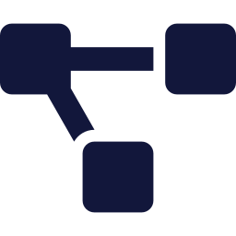

STEP 4
Four Clustering Algorithms,
One Dataset
Each algorithm makes different assumptions about cluster shape, density, and boundaries. Running all four on the same PCA-reduced space reveals which assumptions actually fit human activity signals.
K-Means
Hierarchical
GMM
DBSCAN
Centroid-based, assumes spherical clusters
Builds a tree via agglomerative merging
Probabilistic, soft elliptical clusters
Density-based, finds arbitrary shapes
10

Slide 11

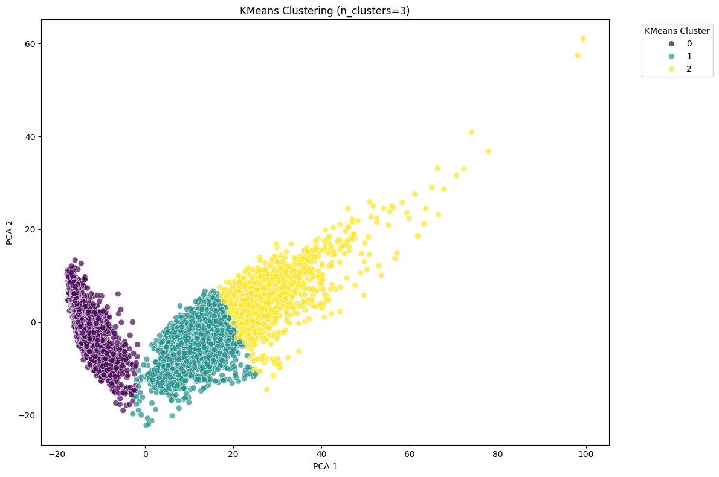
ALGORITHM 1 OF 4
K-Means Clustering
Partitions data into K=3 clusters by minimizing within-cluster variance around centroids — run on the PCA-reduced feature space.
Silhouette Score
0.4239
Highest of all 4 algorithms
Calinski-Harabasz
9,268.6
Highest of all 4 algorithms
Davies-Bouldin
1.2948
Lowest (best) of all 4 algorithms
Human Activity Pattern Discovery — A Comparative Clustering Analysis
11

Slide 12

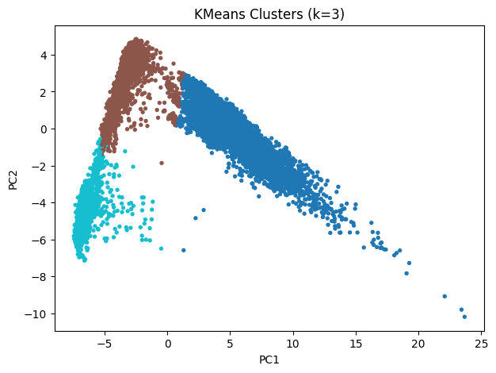
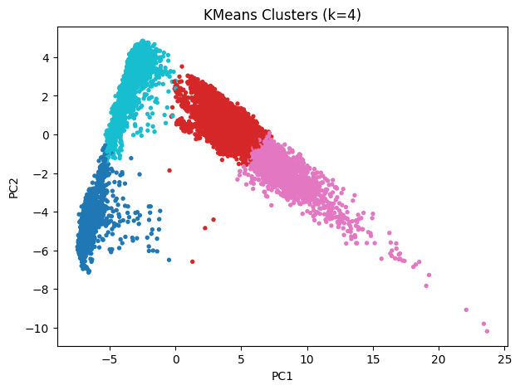
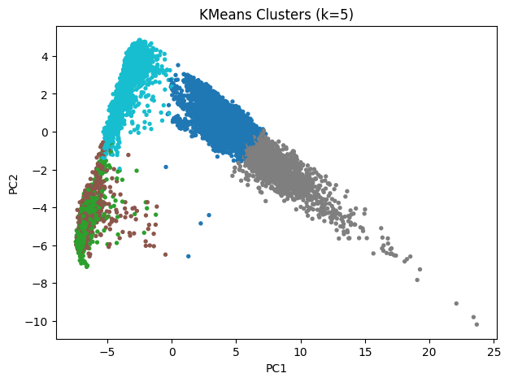
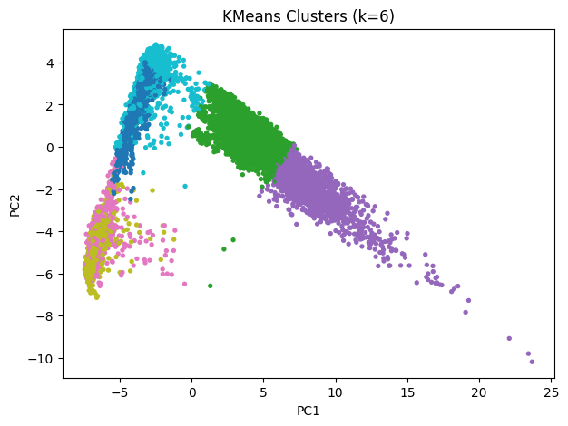
KMeans Clusters Across k Values
PCA (2-component) projections for k = 3, 4, 5, and 6
k = 3
k = 4
k = 5
k = 6
Human Activity Pattern Discovery — Clustering Analysis
12

Slide 13

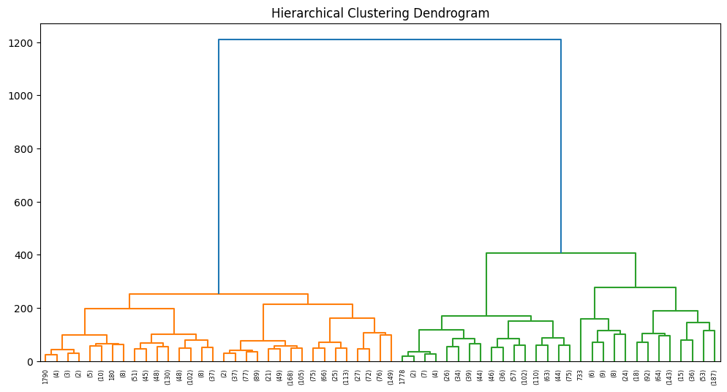
ALGORITHM 2 OF 4
Hierarchical (Agglomerative) Clustering
Ward-linkage clustering builds a tree of merges from the bottom up. Since the full dataset (10,299 rows) is too large for an efficient distance matrix, a random sample of 3,000 rows was used for the dendrogram.
Silhouette Score
0.2932
Calinski-Harabasz
1,556.1
Davies-Bouldin
1.8429
Dendrogram (Ward linkage, truncated to 5 levels) — branch heights show merge distance
Human Activity Pattern Discovery — A Comparative Clustering Analysis
13

Slide 14

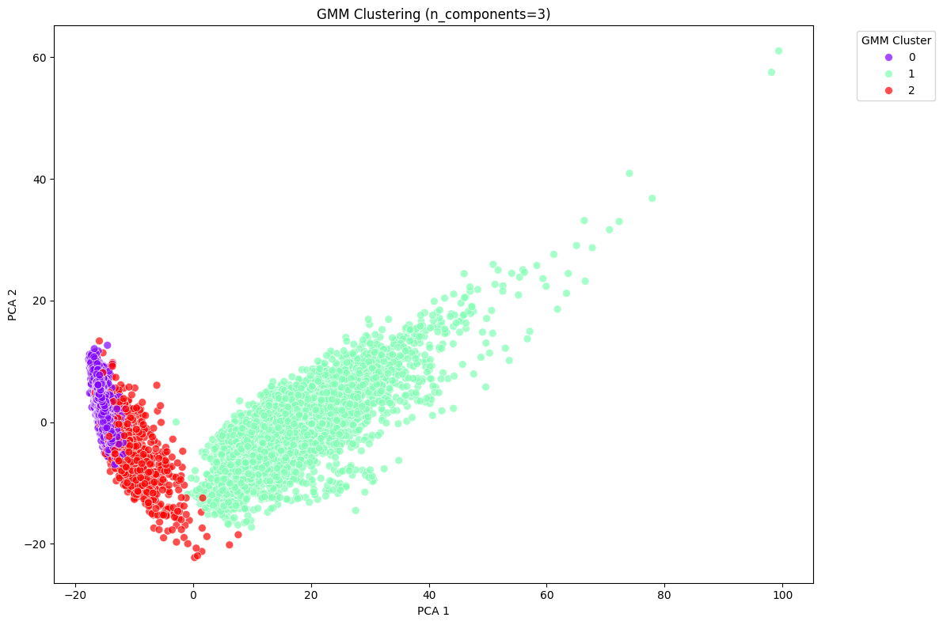
ALGORITHM 3 OF 4
Gaussian Mixture Model (GMM)
Models data as a mixture of 3 Gaussian distributions, assigning soft (probabilistic) cluster membership rather than hard boundaries.
Silhouette Score
0.3021
Calinski-Harabasz
7,307.9
Davies-Bouldin
1.5225
Second-best overall — strong Calinski-Harabasz score, but softer boundaries blur some activity transitions.
Human Activity Pattern Discovery — A Comparative Clustering Analysis
14

Slide 15

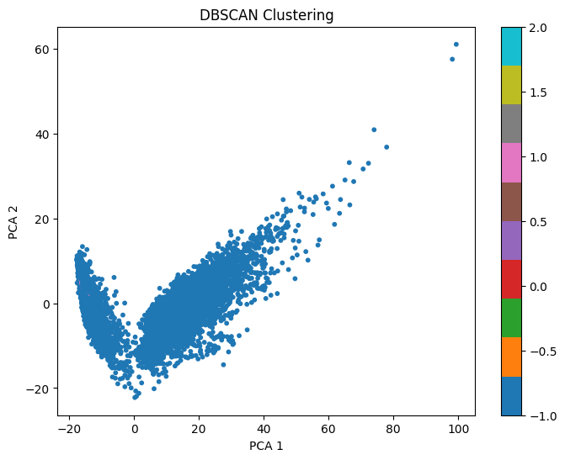
ALGORITHM 4 OF 4
DBSCAN
Density-based clustering that groups points by neighborhood density (eps=3, min_samples=10) and labels sparse points as noise — no need to pre-specify K.
Silhouette Score
-0.2224
Calinski-Harabasz
55.9
Davies-Bouldin
1.8039
In this high-dimensional PCA space, density is too uniform — DBSCAN collapses almost everything into a single cluster, producing weak, negative-leaning metrics.
Human Activity Pattern Discovery — A Comparative Clustering Analysis
15

Slide 16
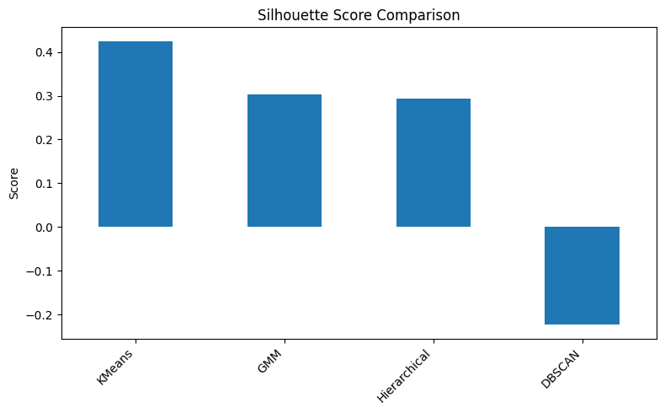
STEP 5
Head-to-Head Comparison
Algorithm | Silhouette ↑ | Calinski-Harabasz ↑ | Davies-Bouldin ↓ | Overall Rank
K-Means | 0.4239 | 9,268.59 | 1.2948 | 1st
GMM | 0.3021 | 7,307.91 | 1.5225 | 2nd
Hierarchical | 0.2932 | 1,556.11 | 1.8429 | 3rd
DBSCAN | -0.2224 | 55.93 | 1.8039 | 4th
Rank = sum of per-metric ranks (Silhouette desc + Calinski-Harabasz desc + Davies-Bouldin asc) — lower combined rank is better.
READING THE METRICS
Silhouette: higher (→1) = better-separated clusters
Calinski-Harabasz: higher = more compact & separated
Davies-Bouldin: lower (→0) = better separation
Human Activity Pattern Discovery — A Comparative Clustering Analysis
16

Slide 17

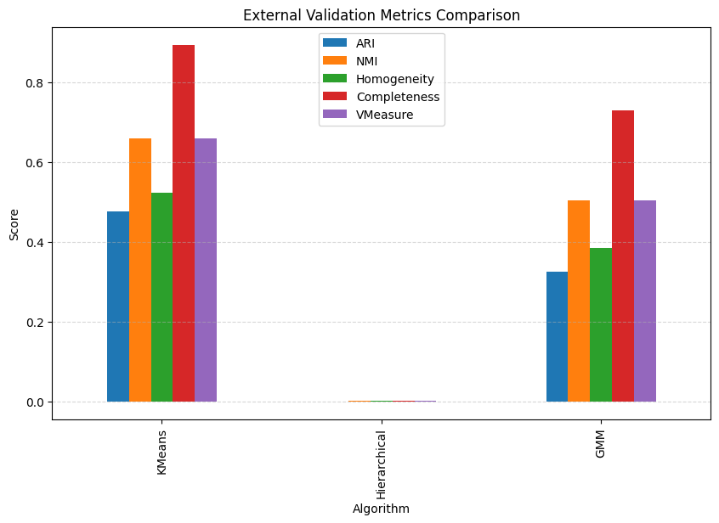
Algorithm Comparison: External Validation
Agreement between cluster assignments and the true activity labels
Algorithm | ARI | NMI | Homog. | Complete. | V-Measure
KMeans | 0.4765 | 0.6597 | 0.5224 | 0.8947 | 0.6597
Hierarchical | -0.0001 | 0.0009 | 0.0008 | 0.0013 | 0.0009
GMM | 0.3255 | 0.5034 | 0.3843 | 0.7293 | 0.5034
Completeness is consistently the highest external score for every algorithm (0.89 for KMeans) — meaning each true activity tends to fall within a single cluster. Homogeneity is comparatively lower, telling us each cluster contains more than one true activity. This is the quantitative fingerprint of activities merging into broader clusters, not clusters splitting activities apart.
Human Activity Pattern Discovery — Clustering Analysis
17

Slide 18
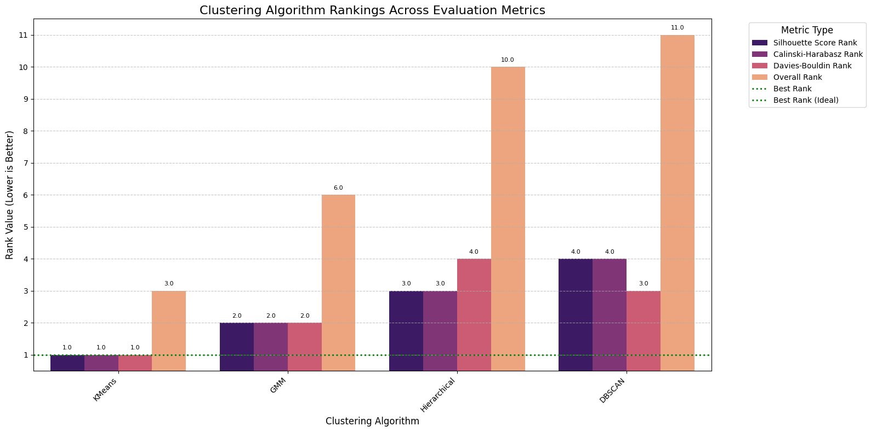
STEP 5 (CONT.)
Ranking Every Metric Side by Side
Per-metric rank (1 = best) for each algorithm — K-Means stays near the top across every dimension, while DBSCAN trails consistently.
Human Activity Pattern Discovery — A Comparative Clustering Analysis
18

Slide 19
Key Finding: Six Activities, Three Natural Clusters
The most important result of this project
Clustering is unsupervised — the algorithm never sees the six activity labels, it only groups observations by similarity. Since k = 3 produced the highest silhouette score of any value tested (including k = 6), the data itself indicates that the six labeled activities are not equally separable in feature space, and naturally collapse into three broader behavioral categories.
Cluster | Walking | Upstairs | Downstairs | Sitting | Standing | Laying
C0 — Dynamic | 40% | 35% | 25% | 0% | 0% | 0%
C1 — Upright/Static | 0% | 0% | 0% | 55% | 45% | 0%
C2 — Resting | 0% | 0% | 0% | 0% | 0% | 100%
Dynamic Activities
Static Upright
Resting
Walking, Walking Upstairs, Walking Downstairs merge — all involve continuous, repetitive locomotion.
Sitting and Standing merge — both are still, upright postures hard to distinguish from accelerometer/gyroscope signal alone.
Laying remains fully separate — its orientation relative to gravity is unmistakably different from all other postures.
Human Activity Pattern Discovery — Clustering Analysis
19

Slide 20
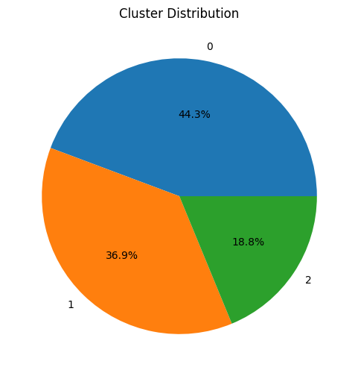
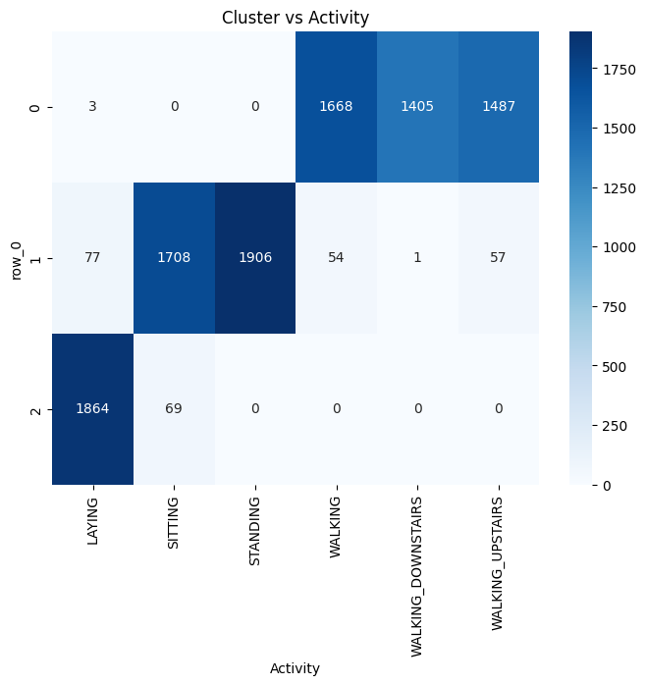
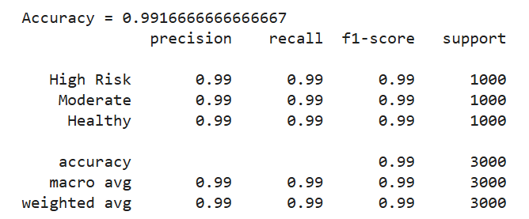
Cluster Composition at k = 3
How the chosen KMeans solution distributes samples and aligns with activities
Cluster Sizes
C0
4,563
C1
3,803
C2
1,933
Purity
0.528
Human Activity Pattern Discovery — Clustering Analysis
20

Slide 21

FINAL VERDICT
K-Means Wins
BEST ALGORITHM
K-Means
Across all three evaluation metrics, K-Means delivered the most balanced, well-separated clustering of human activities from raw sensor signals.
n_clusters
3
Highest Silhouette Score (0.4239) — clusters are well-separated and internally tight
Silhouette
0.4239
Highest Calinski-Harabasz Index (9,268.6) — strong between-cluster vs. within-cluster variance ratio
Calinski-Harabasz
9,268.6
Lowest Davies-Bouldin Index (1.2948) — minimal cluster overlap
Davies-Bouldin
1.2948
Overall rank
#1 of 4
Activity signals form roughly spherical, evenly-sized groups in PCA space — exactly what K-Means assumes
Human Activity Pattern Discovery — A Comparative Clustering Analysis
21

Slide 22

WRAP-UP
Key Takeaways
Preprocessing drives results
Cluster geometry matters
Standardization + PCA (561 → 104 features, and using random forest finally 50 features) was essential before any algorithm could separate activities cleanly.
Activity signals cluster into roughly spherical, evenly-distributed groups — favoring centroid-based methods like K-Means.
Density methods underperform here
Multi-metric evaluation is essential
DBSCAN struggled because high-dimensional PCA space lacks the sharp density contrast it needs.
No single metric tells the full story — combining Silhouette, Calinski-Harabasz, and Davies-Bouldin gave a robust, balanced verdict.
Human Activity Pattern Discovery — A Comparative Clustering Analysis
22

Slide 23

Conclusion
Although the Human Activity Recognition dataset contains six labeled activities, silhouette analysis indicated that the optimal number of clusters was three (Silhouette Score = 0.4459). This suggests that the sensor measurements naturally form three broader behavioral groups rather than six completely distinct classes.
Walking-related activities (walking, walking upstairs, walking downstairs) grouped together as dynamic activities; sitting and standing grouped as static upright activities; and laying formed a separate resting cluster. The clustering process captured the intrinsic structure of the data, while the six-class labeling represents a finer-grained supervised categorization.
KMeans (k=3) was the strongest performer overall — highest Silhouette (0.4459), lowest Davies-Bouldin (0.8894), and highest external agreement (ARI 0.4765) among the three algorithms compared.
Human Activity Pattern Discovery — Clustering Analysis
23

Slide 24
Thank You
Human Activity Pattern Discovery Using Smartphone Sensor Data — A Comparative Clustering Analysis
Questions & Discussion

